Slide 1
Power Efficient Distant Controlled Smart Irrigation System for AMAN and BORO Rice
Paper ID: 244
Rahat Hossain Faisal, Chandrika Saha, Md. Hasibul Hasan and Palash Kumar Kundu
Presented by
Department of Computer Science and Engineering,
University of Barisal

Slide 2
Introduction
Irrigation: Vital part of rice cultivation!
Scenario of Bangladesh:
Primary food is rice
Irrigation is manual
AUSH, AMAN and BORO rice verities cultivated
AMAN contains 60% rice production
BORO: Higher production but less cultivated

Slide 3
Introduction: Objective
Automate Irrigation Process
Low cost solution
Saving water resources
Saving energy
Motivating farmers to grow more BORO rice

Slide 4
Existing Works
Soil moisture sensor based system for small garden [1]
Multi sensor based system for winter crops [2]
A raspberry pi based system for irrigation [3]
Sensor motes based garden watering system [4]
Smart irrigation system using moisture and temperature sensors [5]

Slide 5
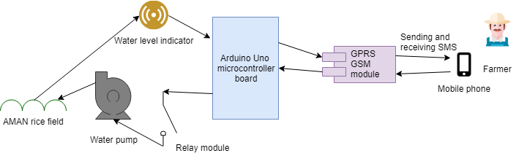
Methodology
Fig. 1: Overall System

Slide 6
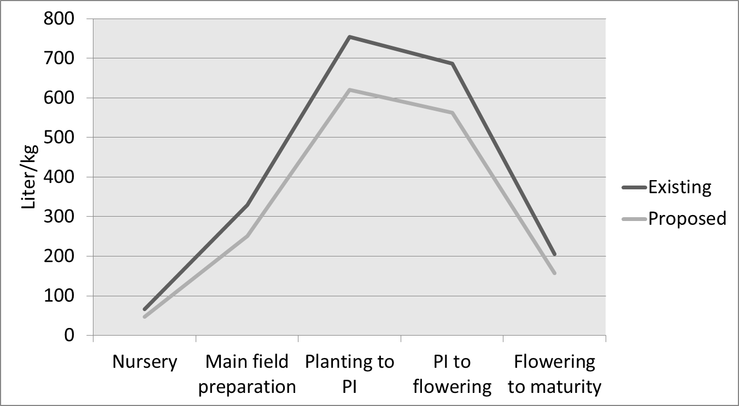
Result & Discussion: Water consumption improvement over existing system
Growth stage | Water requirement in liter/kg for Existing system [6] | Water requirement in liter/kg using proposed system | Improvement(in percentage)
Nursery | 66 | 46.925 | 28.82%
Main field preparation | 330 | 250.625 | 23.82%
Planting to PI | 755 | 619.841 | 17.88%
PI to flowering | 687 | 562.268 | 18.18%
Flowering to maturity | 206 | 157.015 | 23.78%
Total | 2044 | 1636.675 | 19.91%

Slide 7
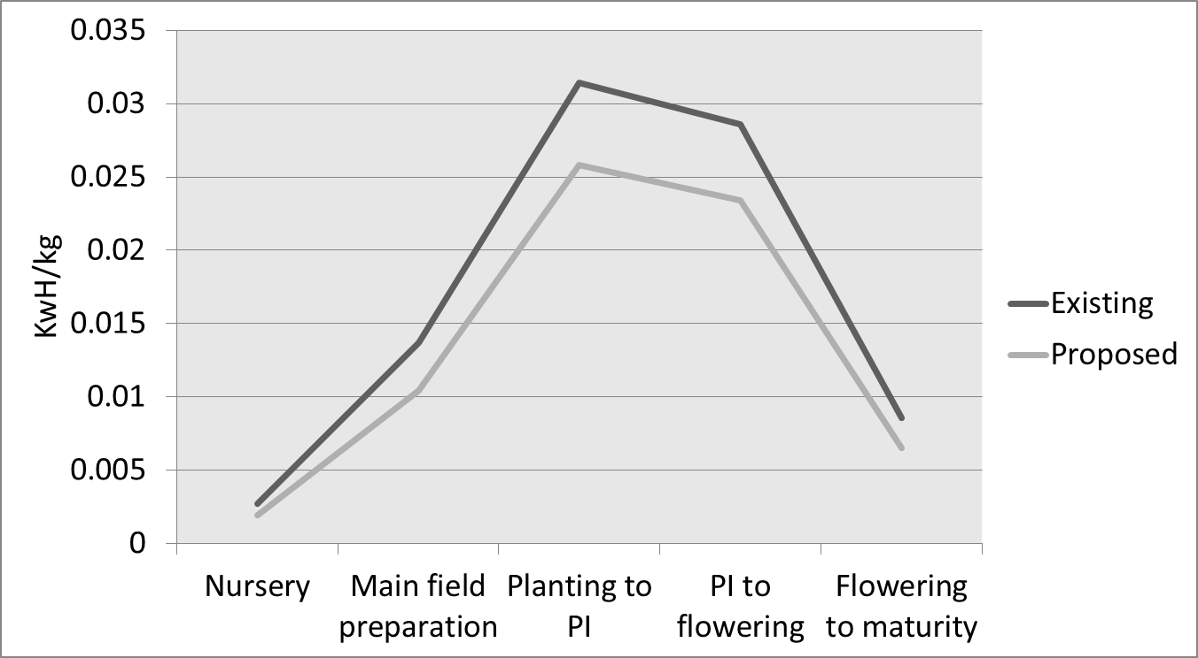
Result & Discussion: Energy consumption improvement over existing system
Growth stage | Energy consumption in KWh/kg for Existing system [6] | Energy Consumption in liter/kg using proposed system | Improvement(in percentage)
Nursery | .0027 | .0020 | 25.92%
Main field preparation | .0137 | .0104 | 24.08%
Planting to PI | .0314 | .0258 | 17.83%
PI to flowering | .0286 | .0234 | 18.18%
Flowering to maturity | .0086 | .0065 | 24.42%
Total | .0850 | .0681 | 19.88%

Slide 8
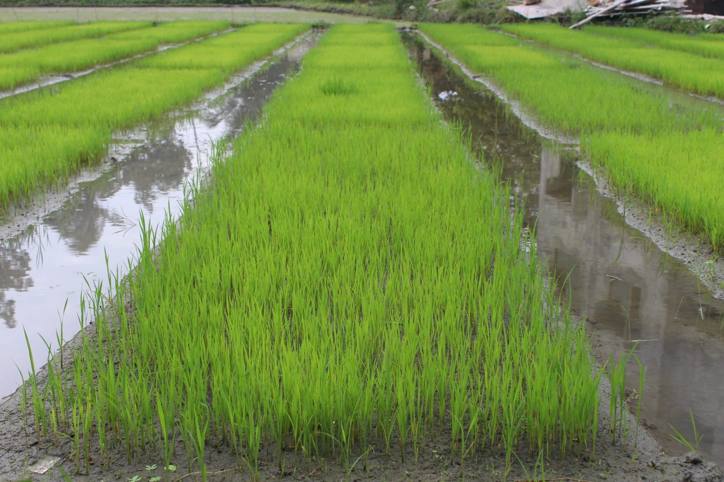
Result & Discussion
Fig. 2: Sample Field

Slide 9
Conclusion & Future Work
Conclusion:
Energy efficient smart irrigation system is proposed
Better performance than existing irrigation system
Future Work:
Upgrade the system to handle any kind of irrigation
Integrate weather prediction

Slide 10
References
[1] Ale, D. T., and E. O. Ogunti. ”Development of a Smart Irrigation System.” International Journal of Science and Engineering Investigations
[2] S.G.Manoj Guru, P.Naveen,R.Vinodh Raja, V.SrirengaNachiyar Smart irrigation system using arduino SSRG International Journal of Electronics and Communication Engineering - (ICRTECITA2017) - Special Issue March 2017.
[3] Sahu, Chandan Kumar, and Pramitee Behera. ”A low cost smart irrigation control system.” Electronics and Communication Systems (ICECS), 2015 2nd International Conference on. IEEE, 2015.
[4] Angelopoulos, Constantinos Marios, Sotiris Nikoletseas, and Georgios Constantinos Theofanopoulos. ”A smart system for garden watering using wireless sensor networks.” Proceedings of the 9th ACM international symposium on Mobility management and wireless access. ACM, 2011
[5] Darshna, S., Sangavi, T., Mohan, S., Soundharya, A. and Desikan, S., 2015. Smart Irrigation System. IOSR Journal of Electronics and Communication Engineering (IOSR-JECE) e-ISSN, pp.2278-2834.
[6] Field survey, Irrigation and Water Management Division, BRRI, Gazipur-1701.

Slide 11
Thank You
Any Questions?

